Slide 1
Sobel Edgeness
Heather Bradfield & Dylan Hart

Slide 2
Background
The Sobel filter is used in image processing and computer vision, particularly within edge detection algorithms where it creates an image emphasising edges.
It is named after Irwin Sobel.
A Sobel filter is calculated by turning the image into a field of vectors. These vectors represent the gradient of the image at each pixel calculated from a 3x3 neighborhood.
This is done by combining the results of two convolutions to calculate the approximate slopes of the X and Y directions.

Slide 3
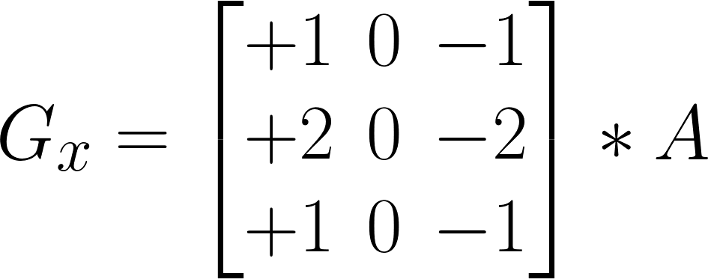
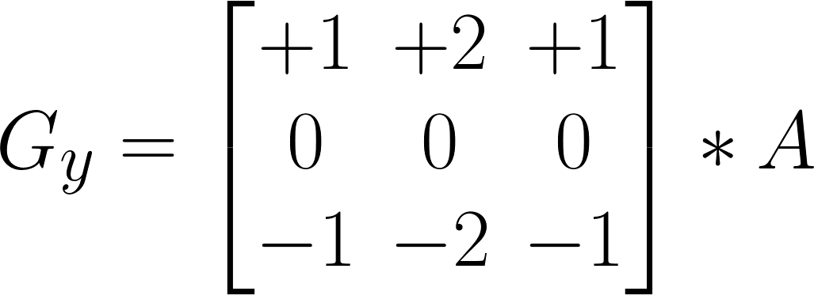
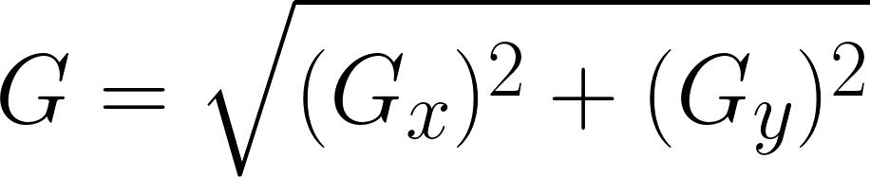
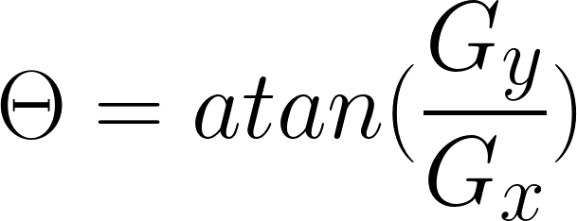
Method
Sobel Formulation:
Notes:
The kernels for this convolution are listed as Gx and Gy
* here denotes the 2-dimensional signal processing convolution operation
At each point in the image, the resulting gradient approximations can be combined to give the gradient magnitude
We can also calculate the gradient's direction or phase

Slide 4
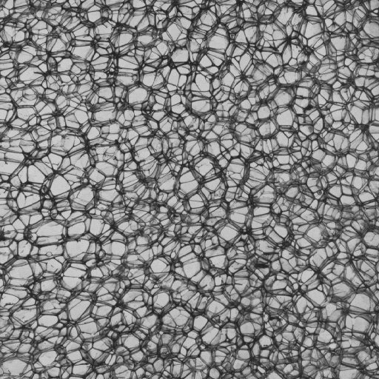
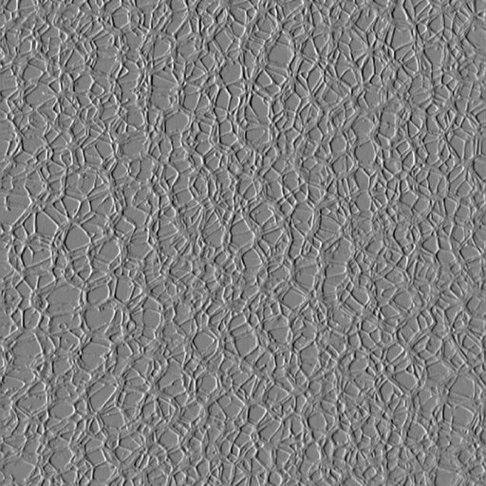
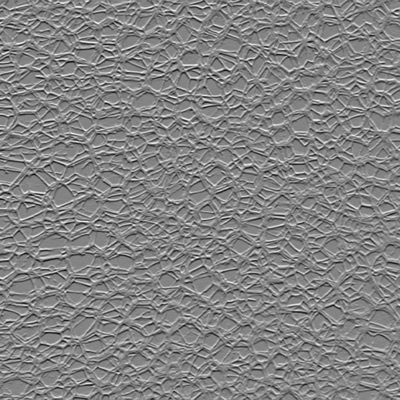
Method
Original (BUBBLES) | X Convolution | Y Convolution
Notes:
The results of these convolutions
Both of the convolutions look very similar, but have a clear difference in direction.
Each pixel in these images make up the X or Y component of that pixel’s gradient vector.

Slide 5
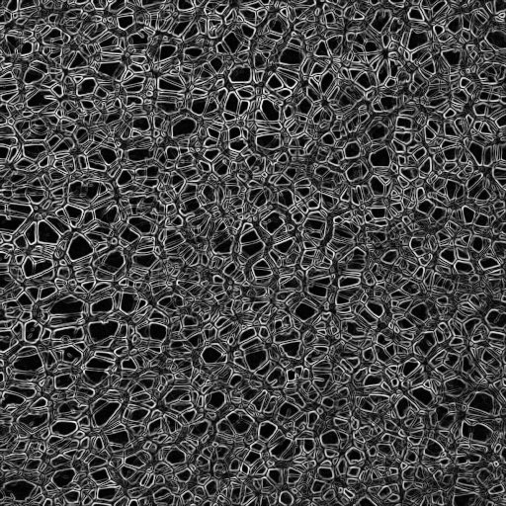
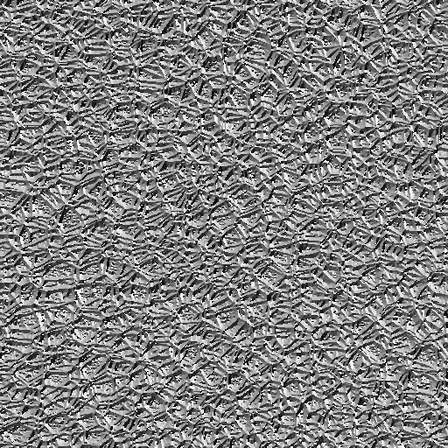
Method
Original (BUBBLES) | Magnitude | Phase
Notes:
The Magnitude image clearly outlines the edges in the original image.
The phase image is a bit harder to read, but it shows the angle of the slope of each point of the original image.

Slide 6
DEMO
Two Plugins:
Sobel.ijm - ImageJ macro that computes the magnitude and phase images
SobelEdgeness_.java - computes the sobel edgeness signature and histogram
Notes:
Our implementation consists of two plugins.
The first is Sobel.ijm which is an ImageJ macro that computes the magnitude and phase images.
It was our first attempt at implementing the problem, but we figured it would be easier to switch to java so that we could use the built in HistogramWindow class.
It was left in as it generates nice examples of the Sobel Filter.
The second is SobelEdgeness_.java which computes the sobel edgeness signature and displays the result using the built in histogram.

Slide 7
Method
Threshold = mean value of the magnitudes of the edgeness for an image
Any point that has an above-average gradient magnitude will be counted as an edge.
Partition edges into N buckets based on their phase values
Bucket width = 2π / N
Bucket height = Sum of the magnitudes of all the edges in the bucket

Slide 8
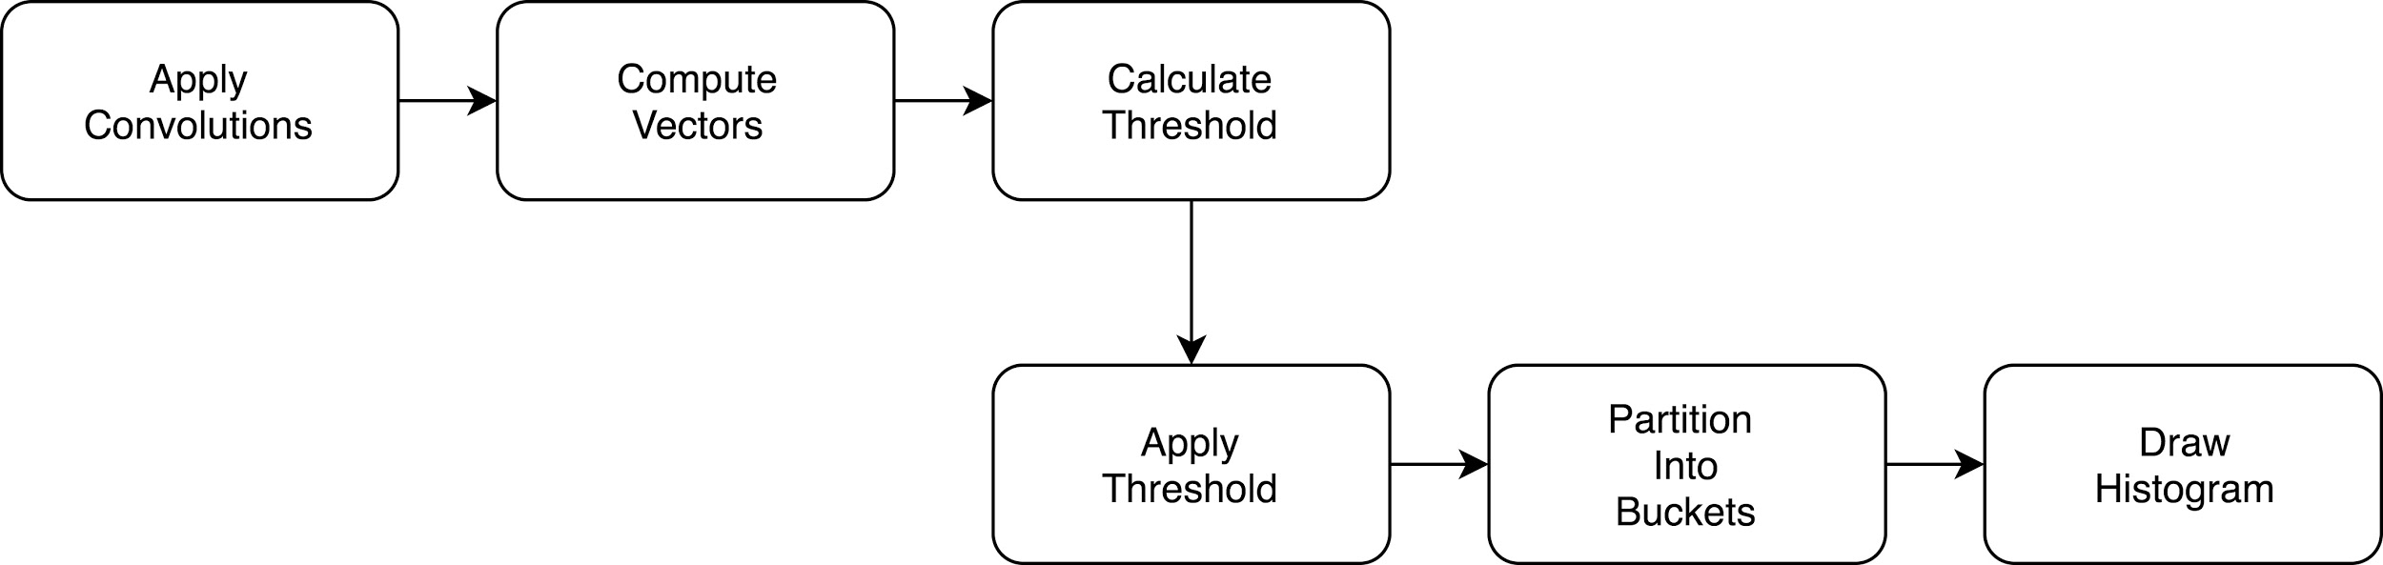
Method
SobelEdgeness Plugin

Slide 9
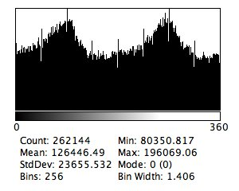
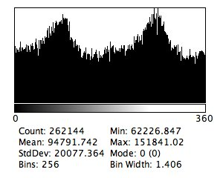
Bubbles.tif
Non-thresholded Signature
Edgeness Threshold: 173.648

Slide 10
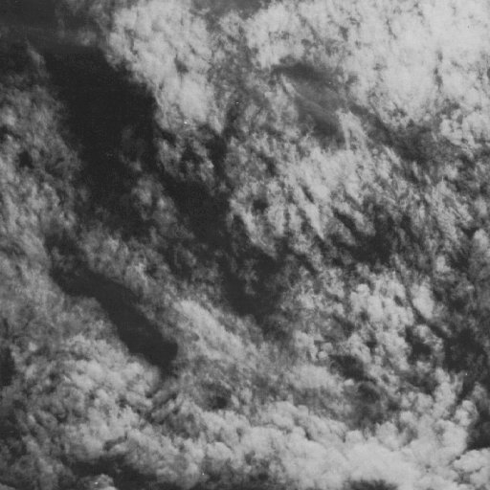
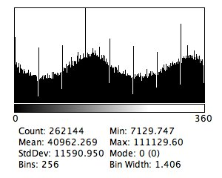
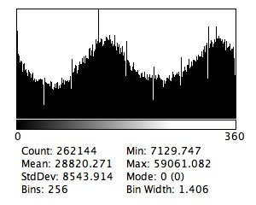
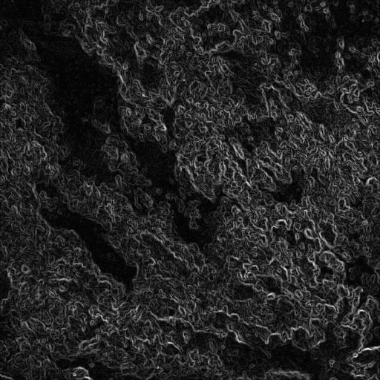
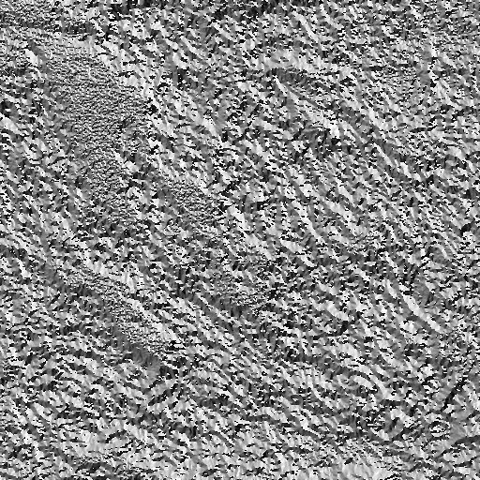
Cloud.tif
Non-thresholded Signature
Edgeness Threshold: 56.253

Slide 11
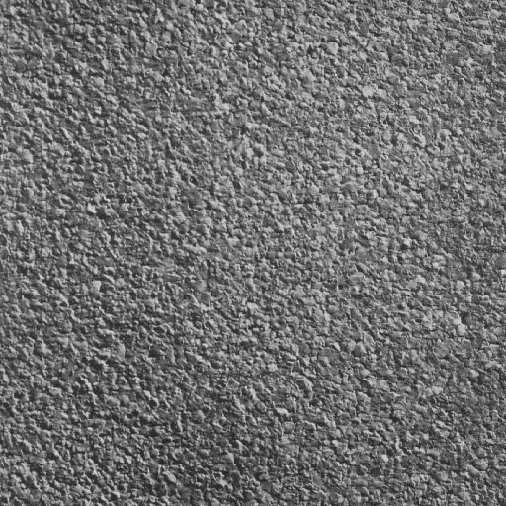
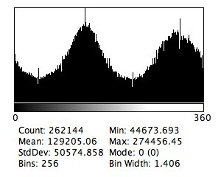
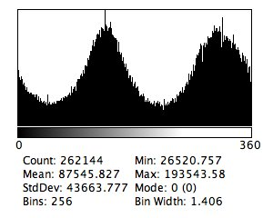
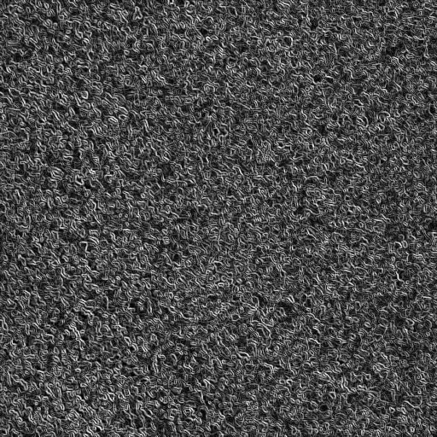
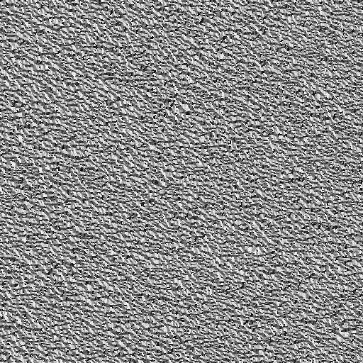
Cork.tif
Non-thresholded Signature
Edgeness Threshold: 177.436

Slide 12
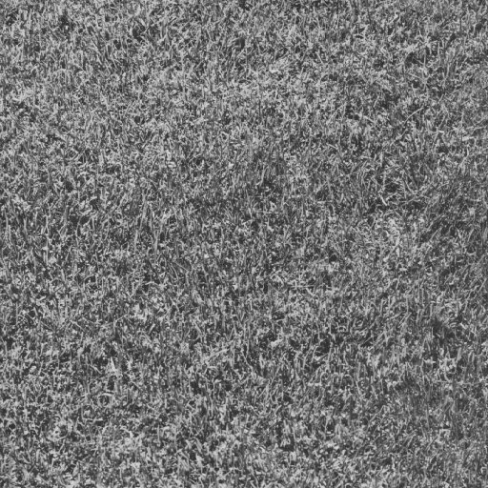
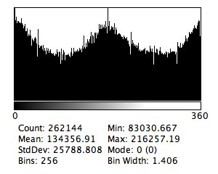
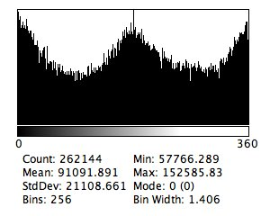


Grass.tif
Non-thresholded Signature
Edgeness Threshold: 184.511

Slide 13
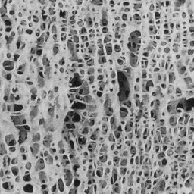
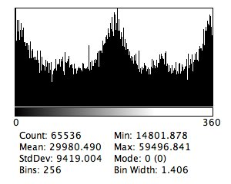
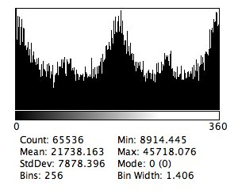
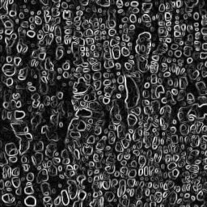
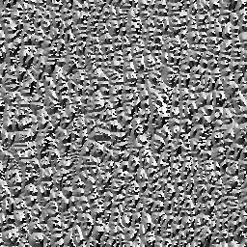
Nonos160.tif
Non-thresholded Signature
Edgeness Threshold: 164.688

Slide 14

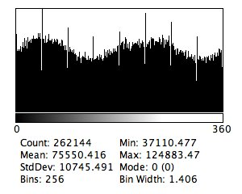
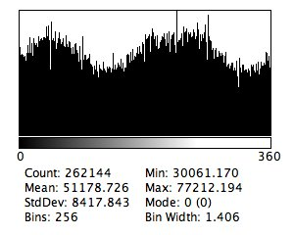
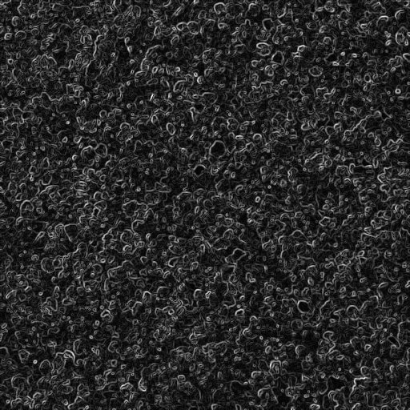

Sand.tif
Non-thresholded Signature
Edgeness Threshold: 103.753

Slide 15
Future Implementation
Custom Histogram class
Live updates - when the image changes, update the signature
Compare Images

Slide 16
References
Irwin Sobel, 2014, History and Definition of the Sobel Operator Geoff Dougherty, 2009, Digital Image Processing for Medical Applications

